Slide 1
他與她的愛情故事

Slide 2

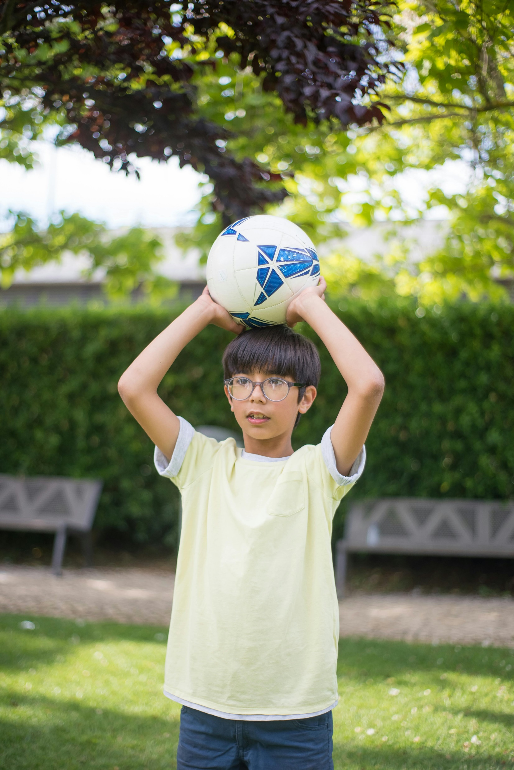
目標
Notes:
https://pixabay.com/photos/girl-student-model-stairs-book-7029035/
https://www.pexels.com/photo/boy-holding-a-football-8813555/

Slide 3
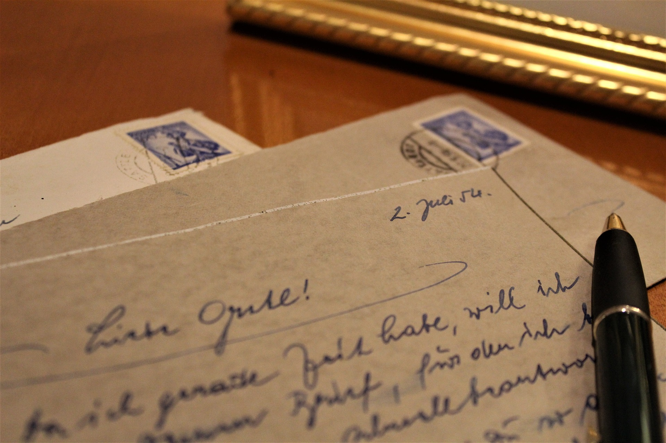
目標
Notes:
https://pixabay.com/photos/letter-old-antique-handwriting-2794201/

Slide 4

阻礙
Notes:
https://pixabay.com/photos/family-beach-people-ocean-6398107/

Slide 5

阻礙
Notes:
https://www.pexels.com/photo/person-holding-letters-4439421/

Slide 6

阻礙
Notes:
https://www.pexels.com/photo/desperate-evicted-male-entrepreneur-standing-near-window-3771129/

Slide 7

努力
Notes:
https://www.pexels.com/photo/silhouette-of-man-247899/

Slide 8

努力
Notes:
https://www.pexels.com/photo/teacher-and-students-posing-together-18739793/

Slide 9

結果
Notes:
https://www.pexels.com/photo/person-holding-letters-4439421/
https://www.pexels.com/photo/crop-diverse-students-taking-notes-5965698/

Slide 10

結果
Notes:
https://www.pexels.com/photo/young-man-and-woman-having-a-conversation-at-school-6209361/

Slide 11

結果
Notes:
https://www.pexels.com/photo/monochrome-photo-of-couple-holding-hands-1004014/

Slide 12

意外
Notes:
https://pixabay.com/photos/kiss-mark-collar-man-concept-idea-5654536/

Slide 13

轉彎
Notes:
https://www.pexels.com/photo/man-in-black-long-sleeve-shirt-and-woman-in-black-long-sleeve-shirt-5616192/

Slide 14

轉彎
Notes:
https://www.pexels.com/photo/a-couple-fighting-8560737/

Slide 15

轉彎
Notes:
https://www.pexels.com/photo/man-looking-at-a-woman-walking-out-of-the-apartment-6643025/

Slide 16

結局
Notes:
https://www.pexels.com/photo/close-up-photo-of-serious-man-with-scar-on-his-face-7265997/

